Slide 1
Intelli-Credit
AI Powered Corporate Credit Appraisal Engine
Team Name : ByteForce
Team Members : Deepak , Sharan

Slide 2




Problem Context
Current Manual Process
01
Collect Documents
Day 1-5
Data Paradox
02
Manual PDF Reading
Day 6-10
Fragmented Sources
03
Cross Verify Financials
Day 11-16
04
Human Bias
Research news/Litigation
Day 17-22
05
Write CAM Memo
Day 23-31
Missed Early Warnings
Total : 4-5 Weeks

Slide 3



Our Solution
Data
Ingestor
Research
Agent
Recommendation
Engine
Input Data -> Ingestor -> Research Agent -> Scoring Models -> CAM Document

Slide 4
Data Ingestor
Unstructured Document Parsing
OCR on scanned Indian PDFs (annual reports, legal notices, sanction letters)
Extracts financial commitments, risk clauses, and covenant terms
Handles multi-language text (Hindi + English mixed)
Databricks style Pipeline
GST vs Bank Statement Cross-Check
Auto-reconciles GSTR-3B declared revenue against bank credit
Flags circular trading patterns and revenue inflation
Detects cash deposit followed by advance payment cycles

Slide 5
Research Agent The Digital Credit Manager — Automated Secondary Research + Primary Insight Portal
Secondary Research
Promoter background & litigation history
Sector headwinds (e.g., new RBI/NBFC rules)
MCA filing status & director changes
e-Courts portal legal dispute scraping
News sentiment analysis (last 3 years)
Primary Insight Portal
Credit officer inputs qualitative notes
"Factory at 40% capacity" → adjusts score
Management interview observations
Site visit findings integrated into risk
AI explains how inputs shift final verdict

Slide 6
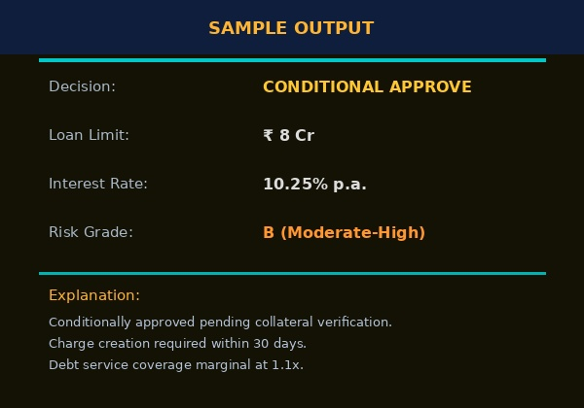
Recommendation Engine
The Five C’s of Credit
Character
Promoter track record, litigation, CIBIL history
Capacity
Revenue, EBITDA margins, debt service coverage
Capital
Net worth, leverage ratios, equity contribution
Collateral
Security value, charge creation, coverage ratio
Conditions
Sector outlook, RBI norms, market conditions

Slide 7
System Architecture
Data Sources
AI Processing Layer
Output
GST Returns
Bank Statements
ITR/MCA
Annual Reports
Legal Notices
News/Web
OCR + PDF Parser(Tesseract/Azure)
Databricks Delta Lake(Data Score)
LLM Analysis
LangChain in Agent(Research)
ML Scoring Model(Risk Score)
RAG Pipeline(Context Retrieval)
CAM(Word/PDF)
Risk Score
Loan Amount
Interest Rate
Rejection Reason
Audit Trail

Slide 8
Architecture Diagram
User
Frontend Layer
API Layer
Processing Layer
OCR Engine
Document Parser
Feature Extraction
LLM Research Agent
Credit Risk ML Model
AI Layer
PostgreSQL
Document Storage
Data Layer
Risk Score
CAM
Report Dashboard
Output Layer

Slide 9
Tech Stack
Data Layer
AI/ML Layer
Ingestion Layer
Backend Layer
Frontend Layer
Databricks Delta
Lake
Lang Chain
Agents
Tesseract OCR
Python/fastAPI
React.js
PostgreSQL
LLM
Azure Form
Recognizer
Redis(cache)
Tailwind CSS
Apache Spark
Scikit-Learn
(scoring)
PyMuPDF
Chart.js/D3

Slide 10
Indian Context Sensitivity
Built Specifically for India’s regulatory and financial ecosystem
GSTR-2A GSTR-3B Reconciliation
MCA21 & ROC Filings
Detects mismatches between ITC claimed and actual supplier filings to spot fraud
Monitors charge creation, director changes, and annual filing compliance status
E-Courts Litigation Scraping
CIBIL Commercial Reports
Scans civil & commercial courts for pending cases against company or promoters
Integrates commercial credit scores and trade references for SME/mid-corp borrowers
RBI / SEBI Regulation Awareness
Sanction Letter Parsing
Tracks sector-specific regulatory changes (e.g., NBFC norms, priority sector rules)
Extracts existing bank credit limits and covenants from multi-bank sanction letters

Slide 11
3 Differentiators That Make Intelli-Credit Bank-Grade
GSTR-2A vs 3B Reconciliation Engine:-Auto-compares supplier-filed GSTR-2A against company-claimed GSTR-3B to detect revenue inflation and fake ITC claims
Promoter Network Graph:-Uses MCA21 director DIN data to build a visual graph of every company a promoter controls — exposing circular lending, shell companies, and cross-collateralization risk
Confidence Score + RBI-Compliant Human-in-the-Loop:-Instead of a black-box yes/no, Intelli-Credit outputs a confidence-banded recommendation with mandatory human review triggers — fully aligned with RBI's 2024 guidelines on AI in credit decisioning
Intelli-Credit doesn't replace the credit manager — it makes them 10x faster and gives regulators everything they need to sleep at night.

Slide 12
Evaluation Criteria
Extraction Accuracy
OCR + LLM extraction pipeline handles scanned, multi-column, Hindi-English Indian PDFs with >80% field accuracy on tested documents
Data Sources
Over 6+ Documents has been Tested : Bank Statements(40) , GSTR-3B(35) , Annual Reports(32) , MCA Data(27) , News Articles(15)
XGBoost , Random Forest , Logistic Regression , SHAP
ML Models used
Native support for GSTR-2A/3B reconciliation, CIBIL Commercial, MCA filings, RBI norms, and regional language documents
Indian Context Sensitivity

Slide 13
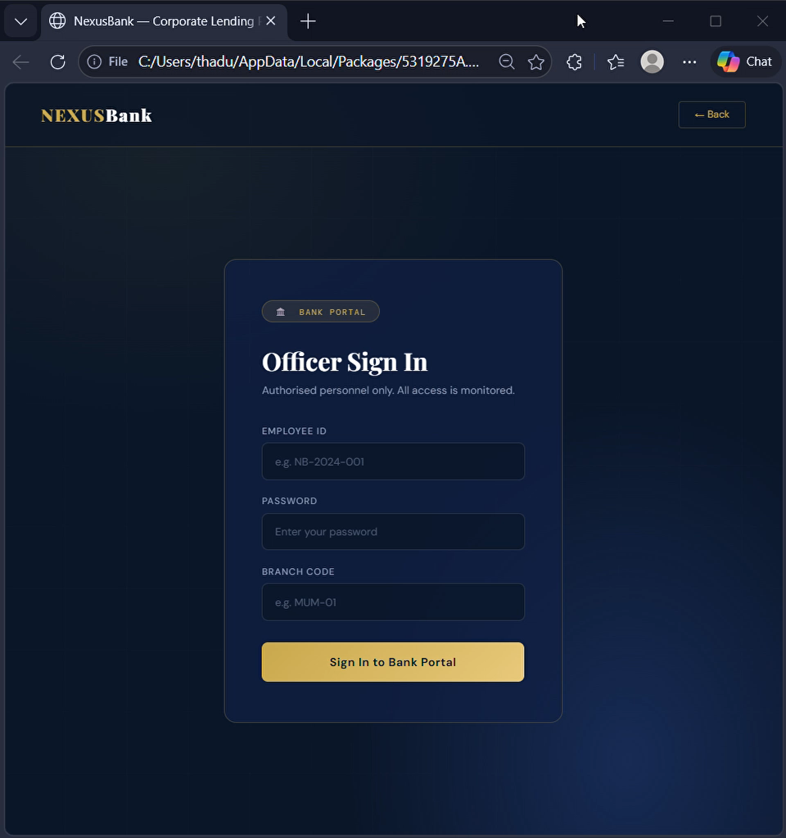
Working Prototype (Video)

Slide 14
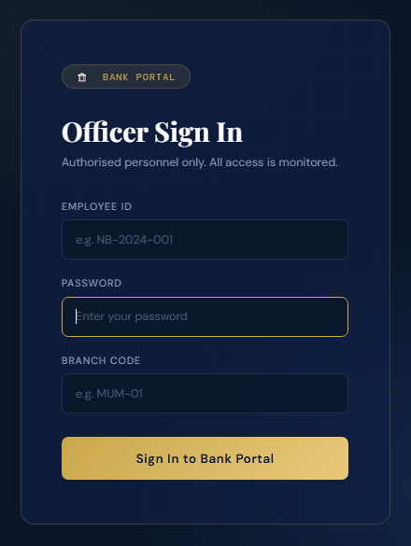
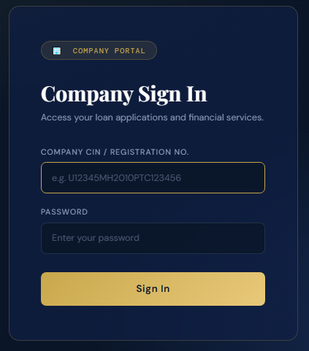
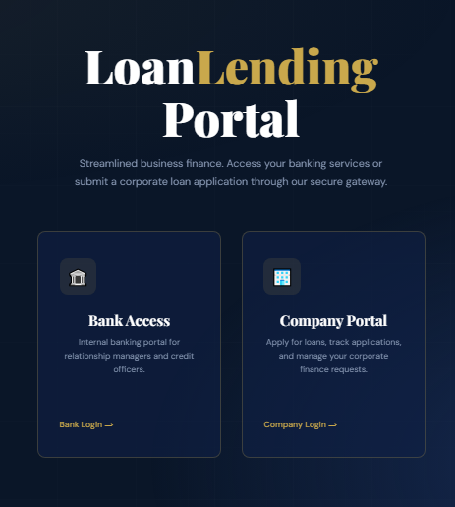
Working Prototype
Three images demonstrating the three pages of the Bank side from the portal

Slide 15
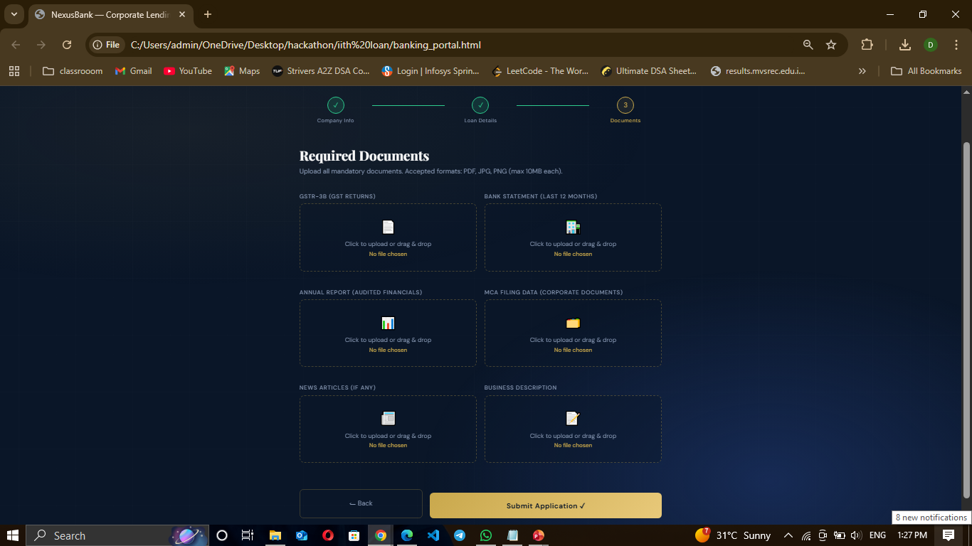
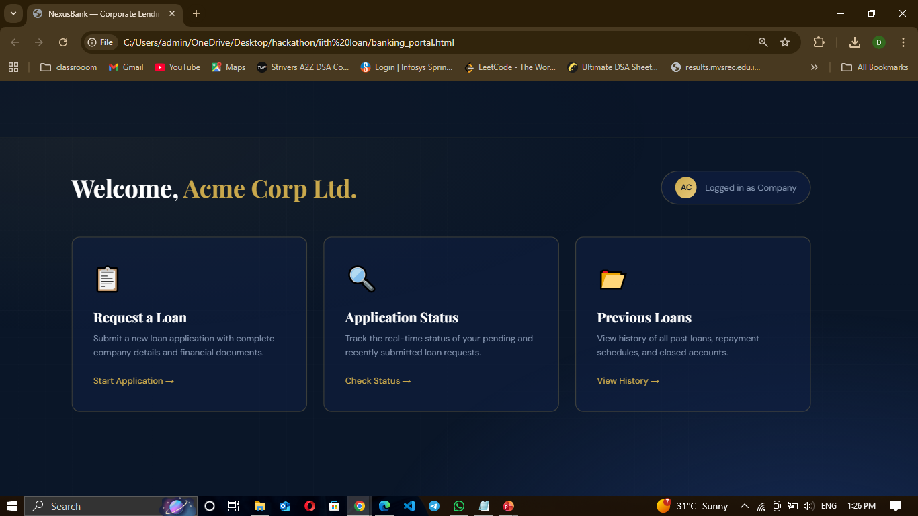
Working Prototype
Two images showing the UI of the page that shows the Company side

Slide 16
Working Prototype Demonstration
User Uploads Documents
OCR Extracts Financial Data
ML Risk Model Processes Data
System Generates Credit Risk Score
Dashboard Displays Recommendation

